Slide 1
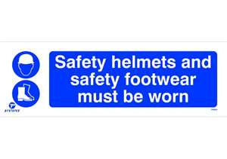
Understanding the management of risks to health and safety on the premises of a retail business
Unit 352

Slide 2
Understanding the management of risks to health and safety on the premises of a retail business
There are four learning outcomes to this unit.
1. Understand the health and safety responsibilities of employees and employers.
2. Understand the management of potential risks to health and safety on the premises of a retail business.
3. Understand the management of emergency procedures on the premises of retail business.
4. Understand the management of accidents in the retail environment.

Slide 3
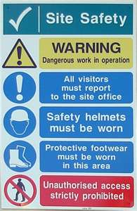
Health & Safety legislation
Legislation in place to protect employees, customers and visitors from harm includes the Health and Safety at Work Act (HASAWA), which says that premises must be safe to work in, and safe for customers and visitors to be in.
Under this Act, colleagues must:
✓✓Follow the training they have received
✓✓Take reasonable care of their own and others’ health and safety
✓✓Co-operate with their employer on health and safety
✓✓Report if they think anyone’s health and safety is being put at risk
Employers must:
✓✓Carry out a risk assessment
✓✓Provide training, equipment and protective clothing as needed
✓✓Provide toilets, washing facilities and drinking water
✓✓Provide first aid facilities
✓✓Insure employees and display the insurance certificate
✓✓Work with employees and health and safety representatives to protect everyone from harm

Slide 4
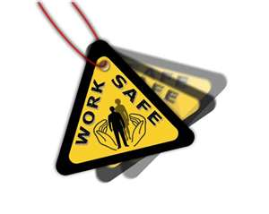
Health & Safety legislation
Another piece of relevant legislation is the Reporting of Injuries, Diseases and Dangerous Occurrences Regulations (RIDDOR)
which says that employers must:
✓✓Notify the enforcing authority without delay and complete an accident report within ten days of death or major injury to an employee or member of the public
✓✓Complete an accident report within ten days of an accident with causes an employee to be unable to work for more than three days
✓✓Complete a disease report when an employee suffers a reportable work-related disease
✓✓Report immediately and complete an accident report within ten days when something
dangerous happens which does not cause a reportable injury but clearly could have done

Slide 5
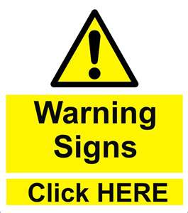
Health & Safety legislation
A list of major injuries, dangerous occurrences and diseases that are reportable is supplied by the
Health and Safety Executive.
A third piece of relevant legislation is the
Control of Substances Hazardous to Health Regulations (COSHH) which require employers to control any substances that may
damage the health of colleagues or customers.
Under these regulations employers must:
✓✓Assess the risk
✓✓Decide how to prevent or reduce the risk
✓✓Monitor exposure to the risk
✓✓Ensure colleagues are properly informed, trained and supervised

Slide 6
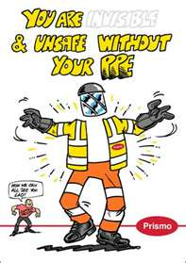
Roles and responsibilities
In a large organisation there will be people with specific responsibilities in relation to health and safety.
In smaller organisations these roles will often be combined.
Fire wardens help to evacuate the premises in the event of an emergency, checking that the area they are responsible for is clear of people before they leave the building.
First aiders must receive adequate training which is regularly updated as they are responsible for initial care in the event of an accident or illness.
Health and safety representatives are usually chosen to cover an area of the premises and attend meetings to discuss health and safety issues.
Through these meetings the health and safety representatives ensure that legislation and company policy on health and safety is understood, implemented and monitored.

Slide 7
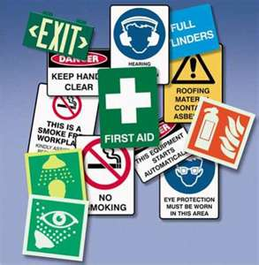
Managing potential risks
Employers must carry out risk assessments at regular intervals and also if the level of risk alters.
When carrying out risk assessments employers must identify the hazards, decide who might be harmed and how, evaluate the risks and decide on precautions, record their findings and implement them.
Risk assessments must be regularly reviewed.
Serious accidents must be reported under RIDDOR, but all accidents, however trivial, must be recorded, as must near misses.
These records must be analysed in order that trends can be identified and the appropriate action taken before a serious incident occurs.
One of the best ways to manage potential risks is to make sure that all colleagues are so well trained and briefed on health and safety and emergency procedures that in the event of an emergency they are able to take the correct action instinctively.
Training and briefing staff can be carried out off the job through workshops, information sheets, distance learning, the internet, books, video and audio resources or on the job through role play and fire drills.

Slide 8
Emergency procedures
Every premise must have a policy and procedure for dealing with emergencies such as bomb threats and fire.
This procedure will cover how to raise the alarm, how to evacuate the building, the location of fire exits, the assembly points, the location of fire fighting equipment and how and when to use it.
Although these procedures will differ, they will have certain things in common which it is important that you know, as an emergency may occur on your first day in a new job or when you are in a shop as a customer.
Basically in the event of an emergency get out of the building, call the fire service out and stay out of the building until told it is safe to return.

Slide 9
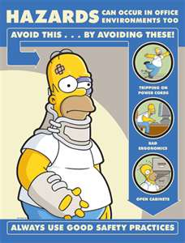
Dealing with accidents
In the year 2009/10 the Health and Safety Executive statistics show that over 2000 major injuries and over 8500 reportable injuries occurred in the wholesale and retail industry.
The types of accident which typically occur on retail premises include slips, trips and falls, injuries from lifting and manual handling, cuts and burns.
These injuries will have been dealt with in the first instance by the first aid personnel and, where necessary, procedures for calling in ambulance crews or directing the injured to seek medical attention.

Slide 10
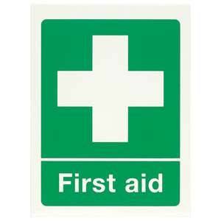
Dealing with accidents
All accidents, whether to staff or customers, must be recorded in an accident book.
The Health and Safety Executive sell an accident book (BI510) which meets all the requirements of legislation. If any other form of recording is used it must record:
✓✓The date and time of the accident or dangerous occurrence
✓✓If the accident happened to someone at work, their full name and occupation
✓✓If the accident happened to someone not at work, the details of the injured person including full name and status, e.g. customer or visitor
✓✓The nature of the injury
✓✓The place where the accident or dangerous occurrence happened
✓✓A brief description of the circumstances in which the accident or dangerous
occurrence happened
✓✓The date and method by which the incident was first reported
to the enforcing authorities
The official book was introduced as many accident books in use did not comply with the Data Protection Act.

Slide 11
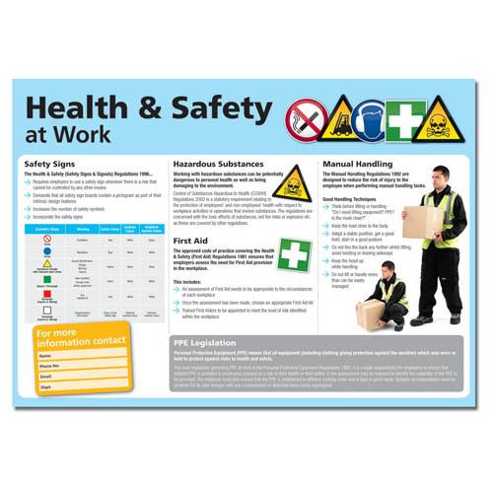
THE END
Thank you and good luck.

