Slide 1
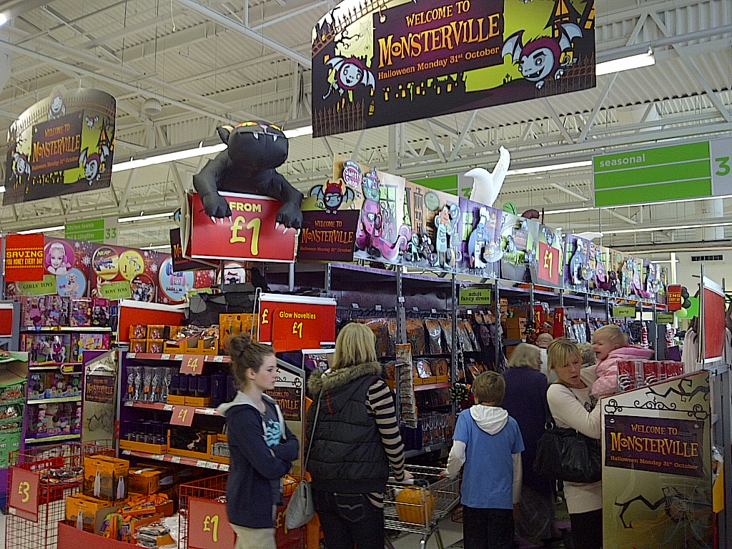
Unit 356:Understanding the management of stock in a retail business
Presented by Bill Haining

Slide 2
356:Understanding the management of stock in a retail business
There are three learning outcomes to this unit.
1. Understand how the receipt and storage of stock is managed.
2. Understand the principles of auditing stock levels.
3. Understand the legal requirements relating to stock management.

Slide 3
Receipt and storage of stock
When expecting a delivery, ensure there is sufficient space to unload the vehicle, sufficient colleagues and the correct handling equipment available.
Lunches and breaks must be planned effectively to ensure enough people are available.
Preparations will depend on the goods expected.
If there is an unloading area check that it is clear of any previous deliveries, stock awaiting return, wrapping and rubbish.
Check the floor has been swept and any obstructions removed.
Check the handling equipment is safe and in working order.
Equipment may include sack barrows, trolleys, pump trucks, cages and running rails.
Put an ‘out of order’ sign on any faulty equipment to avoid it being used as this would be a health and safety risk.
Check that colleagues have received the necessary training before they operate the equipment.
Colleagues may also need wire cutters, safety knives, staple removers, gloves or goggles.

Slide 4
Receipt and storage of stock
Colleagues will need to know when the delivery is due, what types of goods are involved, where it is to be placed and which goods are to be taken directly to the sales floor and which placed in the stock room.
This will enable them to unload the vehicle efficiently, not obstructing access to goods that are required on the shop floor with goods that are for the stock room.
They will also need to be aware of the presence of frozen or chilled food in order to ensure that it is given priority.
If a delivery is not received at the expected time, contact the supplier to find out how long the delay is likely to be, as it may be necessary to rearrange the staffing schedule.

Slide 5
Receipt and storage of stock
Checks must be carried out on the quantity of items, boxes, cartons or sets of hanging goods received, and that all goods are in a saleable condition.
Any discrepancies must be reported to the driver immediately and a note made on the delivery note, which must be signed to confirm acceptance of the discrepancy.
The delivery note will be used when the delivery is being accounted for to ensure that only the goods received are charged for.
Space needs to be available to store the goods in the right place as soon as possible.
Some stock may need to be transferred to hanging rails or stored in freezers or chillers.
Movement of these goods must be monitored to check that their individual characteristics are being taken into account.
For instance, fragile items are not being stored with heavy items stacked on them, fabrics are not being kept in damp conditions and strongly aromatic goods are kept away from other goods.

Slide 6
Receipt and storage of stock
It is also important to monitor the disposal of waste and any stock that has become un-saleable.
Recyclable waste such as cardboard, paper, plastics, glass and metal should be separated and items which must be disposed of in line with legislation, such as fluorescent tubes, asbestos, liquid waste, batteries, oils and waste electrical and electronic equipment must be recorded.
Systems must be in place to record and control stock.
These must be accurate to be of any use, legible so that people can read them, transferable, transparent and auditable.
Systems must be regularly evaluated to identify improvements to stock management.
Feedback should be sought from suppliers, customers and colleagues on the way that stock management works and where improvements can be made.
Documentation should be regularly reviewed to ensure that it is still relevant and fit for purpose.

Slide 7
Stock Auditing
Stock records must be audited regularly to put right any inaccuracies.
Audits may be carried out daily, weekly, and monthly or annually depending on the level of movement of stock and how critical accuracy is.
It is important to anticipate situations which may make it difficult to carry out an audit and take steps to prevent them becoming a problem.
It may be necessary to adjust the timing of stock audits to avoid their clashing with special events as this will lead to a lack of resources to carry out the audit.
Except in businesses which employ specialist stock auditing teams who visit branches specifically to carry out audits, colleagues will need to be re-deployed from their primary functions.
This can have the effect of reducing customer service and security cover, so needs to be planned well.

Slide 8
Stock Auditing
Stock auditing will take time, as accuracy is important and, often, stock will need to be counted twice to enable a check to be made on the original count.
In many businesses stock is counted electronically by scanning the bar code, in others stock must be counted manually and the number counted written down.
Where discrepancies between stock records and physical stock are found, investigations are carried out in the following order; re-check the physical stock, re-check documentation on goods received and despatched; check records of damaged and written-off stock.
Remember to amend the stock record to reflect the physical stock or the same discrepancy will be carried forward to the next audit.
When the investigations are complete and the results adjusted, preventative action may be needed including reviewing colleagues’ training, reviewing procedures and improving security.

Slide 9
Legal Requirements
Some products have legal requirements that set out the way they may be stored.
The Food Safety Act says that food must be stored and transported in ways that do not produce any risks to people who consume it.
The Food Safety (Temperature Control) Regulations require potentially dangerous foods to be stored at or below 8°C while frozen food must be stored at -18°C or below.
Toxic items must be stored in compliance with the Control of Substances Hazardous to Health Regulations (COSHH). These require that stock is stored according to the manufacturer’s instructions, a minimum quantity is kept, incompatible substances are stored separately, a spill kit is kept handy and used promptly, protective clothing and ventilation is provided, proper training is carried out, proper labelling is in place and flammable stock is not stored near to a source of ignition.

Slide 10
Legal Requirements
Bonded items must be stored in a bonded warehouse as they are dutiable products on which the duty has not yet been paid.
They will usually be stored in locked cages or separate areas with increased security.
The disposal of waste and un-saleable stock is controlled by a number of regulations.
There are currently 17 waste regulations in force, and failing to comply with them can lead to fines or imprisonment of individuals responsible and loss of trade, loss of reputation and potentially closure of the business.

Slide 11
THE END
Thank you and good luck

