Slide 1


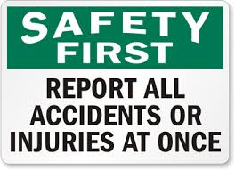
Complying With Regulations & Safety requirements,
How to deal with specific Safety regulations
Notes:
Intro slide

Slide 2

QCF, TC, ERR
All employers must, by law, display this health and safety law poster in all workplaces.
It explains the responsibilities of the employer and employee in relation to health and safety.
Go & Locate the H&S poster

Slide 3
Main Legislation HASWA 1974
Health & Safety at Work Act 1974
An ‘umbrella’ to all other legislation we must follow
Manual Handling Operation Regulations 1992
Control of Substances Hazardous to Health 2002
COSHH
Reporting of Dangerous Injuries, Diseases and Dangerous Occurrences Regulations 1995
RIDDOR
Fire Precautions Act1971

Slide 4
Health and safety legislation
Employers | Employees
Carry out risk assessments to highlight hazards and risks Provide a safe working environment Provide training Provide PPE Provide supervision Appoint someone competent to assist with health and safety Provide first aid facilities Provide a health and safety policy | Obligated to follow safe systems of work Maintain a constant eye for hazards and report them Use equipment as trained Take responsibility for own health and safety Work in a safe manner Not misuse or interfere with anything provided for your health and safety.
Notes:
Highlight aims and objectives-cover these 3 main types as an overview

Slide 5
Health and Safety policies= E.R.R, TC, QCF
Question : State where to find information on company health and safety policies.
Induction
Company website
Contract of employment
Asking managers/members of staff
Staff hand book
Notice boards
Posters
Staff meetings
Emails
Notes:
Typical notice seen where chemicals are used.
Highlight employers responsibilities and employees too...................cover pages 8/9
Key messages are...risk assessments, control, safe storage, training a “data sheet” and where appropriate safe disposal.

Slide 6
RIDDOR= TC, QCF, ERR
RIDDOR requires employers and others to report deaths, certain types of injury, some occupational diseases and dangerous occurrences that ‘arise out of or in connection with work’. Generally, this covers incidents where the work activities, equipment or environment (including how work is carried out, organised or supervised) contributed in some way.

Slide 7
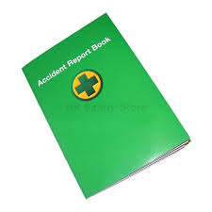
Accident Book
The accident book is also a valuable document that organisations can use to record accident information as part of their management of health and safety. It can be used to record details of injuries from accidents at work that employers must report under the Reporting of Injuries, Diseases and Dangerous Occurrences Regulations (RIDDOR).

Slide 8
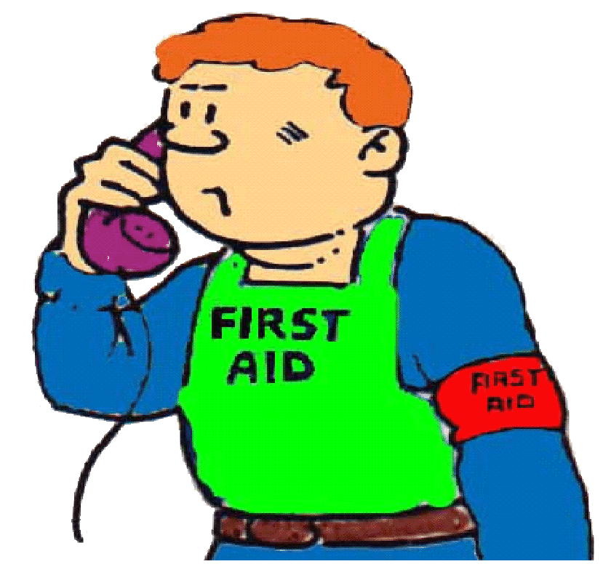
Accident Reporting.
About the person who had the accident
Full name-Home Address & Occupation
About you the person filling in the book
Sign-Date-Home Address & Occupation
About the accident
What percentages of accidents happen in the
workplace?

Slide 9
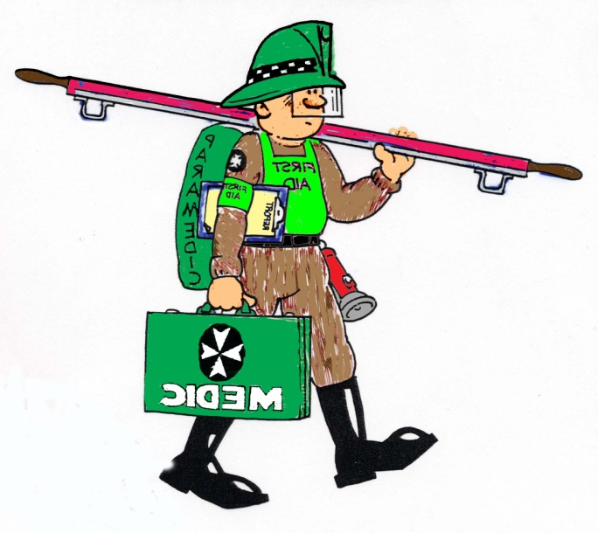
FIRST AIDER ROLE= QCF, TC
The First Aider has an important role within the workplace to assist the management to :
Comply with current legislation
Keep adequate and reliable records
Improve or adapt existing First Aid provisions
Provide adequate equipment and proper surroundings for treatment

Slide 10


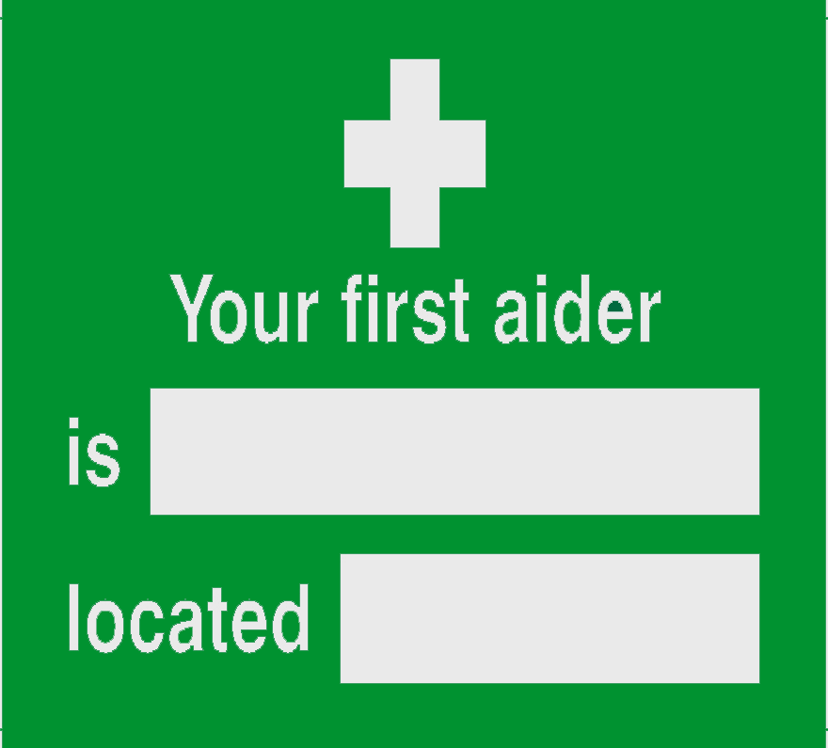

FIRST AID SIGNS
Location chosen carefully
Prominent - green/white
Durable - normally vinyl
Must comply with sign regulations

Slide 11
What are Risk assessments? =TC,NVQ,ERR
1
Look for the hazard
4
Document your findings
5
Review the position after the controls are in place and adjust if needed
2
3
Decide who will be harmed and how
Consider the risk. Put control measures in place
Notes:
Typical notice seen where chemicals are used.
Highlight employers responsibilities and employees too...................cover pages 8/9
Key messages are...risk assessments, control, safe storage, training a “data sheet” and where appropriate safe disposal.

Slide 12
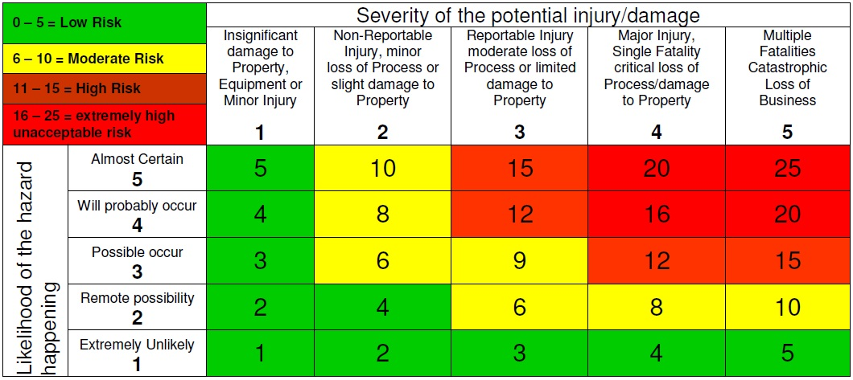
Risk Rating Chart.

Slide 13

The risk of fire QCF, TC
Protective measures that employers must put in place:
Escape routes
Suitable equipment to fight fires
A warning system
Notes:
Use this slide to intro Fire section-page 17
Stating obvious but fire is one of the most serious risks to safety for retail stores not to measure closure and all its attendant issues.
Ask Q what 3 things are needed to start a fire.....next slide

Slide 14

The risk of fire
What can you do to reduce the risk of fire?
Ensure that fire doors are kept closed
Fire exits should be clearly signed and clear of obstructions
Smoke detectors are an early warning system
Fire extinguishers can be used to put out small fires
Notes:
Use this slide to intro Fire section-page 17
Stating obvious but fire is one of the most serious risks to safety for retail stores not to measure closure and all its attendant issues.
Ask Q what 3 things are needed to start a fire.....next slide

Slide 15
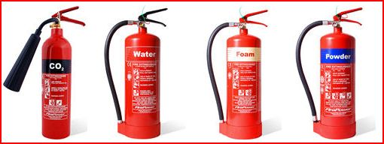
Fire extinguishers
Decide the colour and contents of each fire extinguisher and which types of fire they should or should not be used on
Notes:
This is more extensive than the tribal book but you can enlarge as necessary.
Note wet chemical generally used in places with fryers..ie fish and chip shops.
Note also powder one marked * -not be used for electrical fires over 1000 volts.
Note Awareness one thing...but usage..only if trained and safe to do so.
Cover points at top of page 20
Message must always be... evacuation and saving lives is preferable to having a go and being put at risk.
Complete Assignment 7

Slide 16
Fire extinguishers
Colour of label | Contents | Used for | NOT to be used for
Red | Water | Paper, wood or cardboard fires | Electrical fires or fires caused by flammable liquids
Blue | Powder | Gas or burning liquids | Electrical fires over 1000 volts
Black | Carbon dioxide (CO2) | Electrical fires or burning liquids | Loose paper fires or in a confined space
Cream | Foam | Fats, petrol, thinners or paraffin | Any fire involving electricity
Notes:
This is more extensive than the tribal book but you can enlarge as necessary.
Note wet chemical generally used in places with fryers..ie fish and chip shops.
Note also powder one marked * -not be used for electrical fires over 1000 volts.
Note Awareness one thing...but usage..only if trained and safe to do so.
Cover points at top of page 20
Message must always be... evacuation and saving lives is preferable to having a go and being put at risk.
Complete Assignment 7

Slide 17
Causes of workplace injury= F/S
What is the most common cause of workplace injuries?
Manual handling
36%
Notes:
On to Manual Handling
Biggest single cause of injury is incorrect lifting...mention points on page 20 of tribal book.
So good risk management will try to design out as much lifting as possible or provision of other mechanical aids where possible.

Slide 18
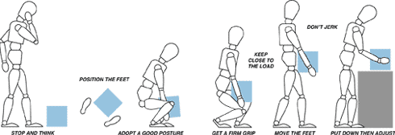
Correct manual handling= QCF, TC
Watch the following video on the correct procedure for manual handling
http://www.youtube.com/watch?v=MhGUkWAA9WM
https://www.youtube.com/watch?v=RuhroEh31i0 -
Notes:
Talk through this slide using points on page 21. and complete assignment 8
You may want to refer to TILE mentioned in unit 5
T; Task
I; individual
L; Load
E; Environment

Slide 19
Correct manual handling
Plan - assessing the task
Position - correctly aligning to lift safely
Grip - ensure full grip and fingers not in a catch position
Lift - using legs not spine
Carry - check environment and able to see
Lower - safely using legs not spine
Notes:
Talk through this slide using points on page 21. and complete assignment 8
You may want to refer to TILE mentioned in unit 5
T; Task
I; individual
L; Load
E; Environment

Slide 20
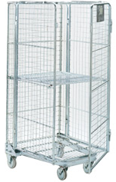
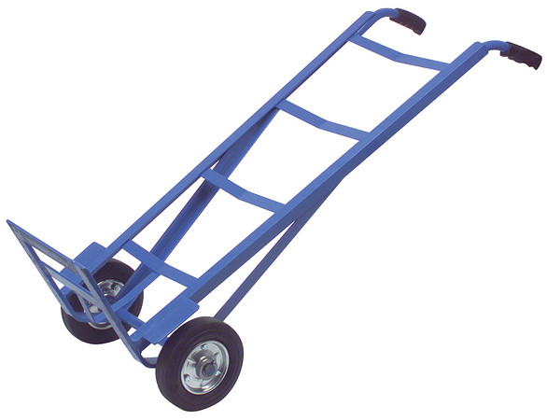
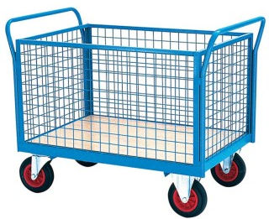
Equipment to help
Give examples of equipment you would move using the lifting equipment shown below.
Mesh trolley
Used for moving folded clothes
Sack truck
Used for moving large electrical goods
Roll cage trolley
Used for moving food and drink
Notes:
Some possible options to help with lifting/manual handling.
Use this as a discussion slide and then as groups to consider activity 6 on page20- can they think of any thing else?
Key thought here-is only use equipment you have been trained to use!!
But it might just come down to having to do it yourself....so get someone to help if necessary but what is good practice...next slide....

Slide 21
PPE = CQF,TC,ERR
Employers have duties concerning the provision and use of personal protective equipment (PPE) at work.
PPE is equipment that will protect the user against health or safety risks at work. It can include items such as safety helmets, gloves, eye protection, high-visibility clothing, safety footwear and safety harnesses. It also includes respiratory protective equipment (RPE).

Slide 22
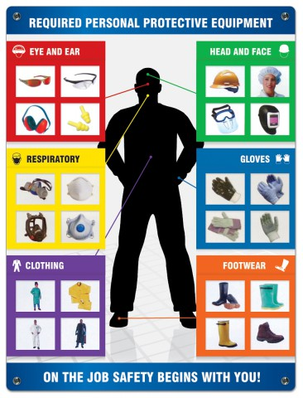
PPE = CQF,TC,ERR

Slide 23
The End

