Slide 1
UNIT 258
Understanding the control, receipt and
storage of stock in a retail business

Slide 2
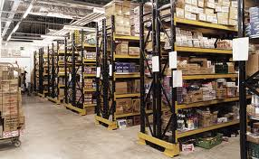
Understanding the control, receipt and storage of stock in a retail business
There are three learning outcomes to this unit:
1.Understand the importance of having the right stock levels
2. Understand how goods are received on the premises of a retail business
3. Understand how stock should be stored to prevent damage or loss

Slide 3
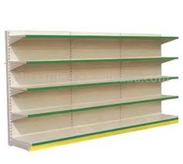
Stock levels
It important to control the level of stock held in the business.
Too much stock can lead to reduced profits through having to reduce prices in order to clear stock before it goes out of date or out of fashion.
It can also lead to an increase in the amount of stock that has to be thrown away and not being able to purchase new stock because of capital being tied up.
Too little stock can lose profit as customers will not be able to buy from you and will take their business elsewhere.

Slide 4
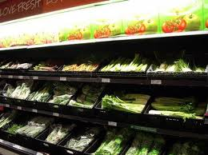
Stock levels
Stock control is carried out either electronically or manually.
Electronic stock control reduces the stock level when goods are scanned through the till.
Received goods are entered onto the system.
The figures can become inaccurate through shoplifting, incorrect barcodes, cashier error or failure to deal correctly with incorrect deliveries, exchanges of goods or damaged goods.
Manual stock control is carried out by physically counting the stock on a regular basis.
In many organisations, there are maximum and minimum stock levels set either by head office or locally.
These may be adjusted in view of recent sales records, seasonal issues or promotions.

Slide 5
Receiving stock
It is important that you know what goods are arriving and when in order to prepare the receiving area.
If there is an unloading area available, clear away any stock awaiting despatch and any rubbish, sweep the floor and remove any obstructions.
Make sure you have any equipment and tools that you will need available.
When the delivery arrives, check carefully that the quantities match the delivery notes and the quality is acceptable.
Check the number of items, boxes, cartons or sets of hanging stock.
Unless you are receiving a sealed load, where the delivery has been checked when the lorry was loaded and the lorry has been sealed in transit, check for correct sizes, colours, etc.
If the delivery is in a temperature controlled vehicle, check that the temperature has been at the correct level throughout the journey.
You will not be able to sell goods that are of poor quality.

Slide 6
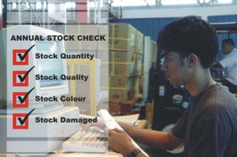
Receiving stock
Having checked the quantity and quality of the delivery, it will be necessary to report any variation in quantity or defect in quality.
The procedures for reporting discrepancies will vary in different types of organisation.
Larger organisations will probably have electronic methods of reporting while smaller organisations will probably do this on paper.
Whatever the procedure, it is important that you advise the delivery driver of the discrepancies and get his signature to confirm what you say.
After reporting the variations you must make sure that the stock records reflect the actual quantities received, not those on the original delivery note.

Slide 7
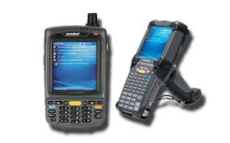
THE END
Thanks and good luck

