Slide 1
Understanding Customer Service in the Retail Sector: Unit 251
Presented by Bill Haining
City and Guilds Assessor

Slide 2
Unit 251
Your Journey Today
1
Customers
2
Delivering Customer Service
3
Getting it Wrong
4
Policies: Standards and Procedures
5
Complaints

Slide 3
251: Customers
Customers are individuals or businesses that may use the services you have on offer, these can include:
Current Customers
Former Customers
Potential Customers
To give all customers effective customer service, you need to know the products and services inside out, listen to the customer, communicate at the correct point and exceed the customer’s expectations.

Slide 4
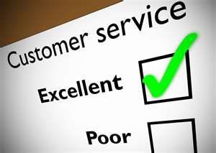
251: Customers
You can have a look at some other retail businesses and see what products and services they offer and compare them to your companies offers:
http://www.apple.com/uk/retail/
http://careers.next.co.uk/retail/index.aspx
http://www.debenhams.com/

Slide 5
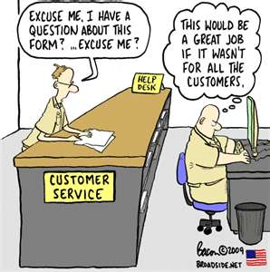
Delivering Customer Service

Slide 6
Delivering Customer Service
Customers may not be able to describe what they need: Your product and services knowledge will help them decide, could be technical, options, size etc.
Its important to to listen to what the customer says: Show you are listening, GOOD BODY LANGUAGE, ask probing (Searching) questions to discover the customers true needs by using a combination of open and closed questions, an open question will invite a full answer e.g. start with what, why , where, etc. and if you require a specific answer then use a closed question e.g. “Is that the colour you require?”, know when to and how to approach customers, not all customers may need your help.
Knowing the right time to approach customers: Each company will have a policy on how and when to approach customer, you need to know this policy “Happy to Help”, knowing will also improve with experience.
“Going the EXTRA MILE”: Is a great way to build up customer rapport (Relationship) and exceeding their expectation e.g. Carrying heavy goods to their car, Gift wrapping presents, ringing another branch if out of stock etc.
Remember you can give the Customer a great shopping experience

Slide 7
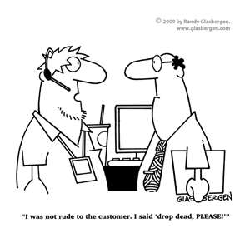
The effect of getting it wrong

Slide 8
The effect of getting it wrong
Customers will always have a choice of where to buy products and services:
Customers now have a wide choice of suppliers and shops, retailers must exceed customers expectations if they are to survive against competition
Customer Loyalty:
Customer loyalty is gained through offering loyalty schemes, discounts to regular customers, promoting products and services to customers etc., all this effort is wasted if the customer service provided is not excellent.
Customers will vote with their feet and go to a competitor if they do not feel valued:
This can be measured using feedback, either formal or informal, feedback can be gathered through word of mouth, complaints, surveys etc.
Remember any information collected is subject to the -
DATA PROTECTION ACT

Slide 9
Customer Service Policies, Services and Procedures.
Most businesses will have customer policies, services and procedures , people can often become confused with these:
Policy: This will state the intention of the company to deliver a high quality of service. It may say “We will greet customers promptly and courteously in our stores”
Standards: This states how the performance of customer service is measured against the policy, it may say “We will respond to complaints within three working days and resolve them within two weeks”
Procedure: Is how the policy and standard will be carried out, it may say “a letter will be written to the customer on receipt of the complaint, the complaint will be investigated and the customer contacted with a decision.
All of the above processes enable customer service to be monitored to ensure all colleagues are delivering an acceptable level of customer service that the company expects and that the customer benefits from a consistent level of service.

Slide 10
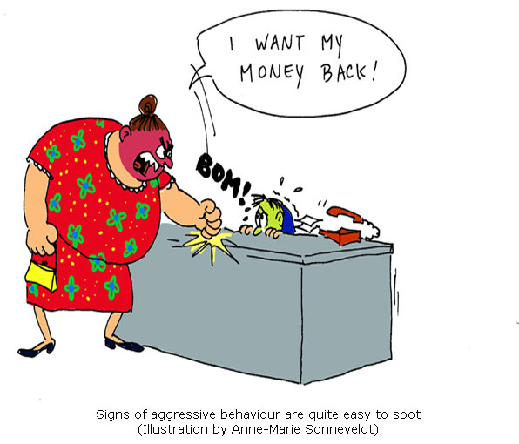
Dealing with Complaints

Slide 11
Dealing with Complaints
Complaints will be related to products, customer service or colleague issues
Make sure you have listened to the complaint fully and understood what it is that’s causing the customer a problem, take the complaint seriously
Investigate whether the complaint is justified, when completed get solution agreed with customer, if no agreement then let them know where they can go next, e.g. your Head office or Trading Standards
.

Slide 12
THE END
Thank you and Good Luck

