Slide 1
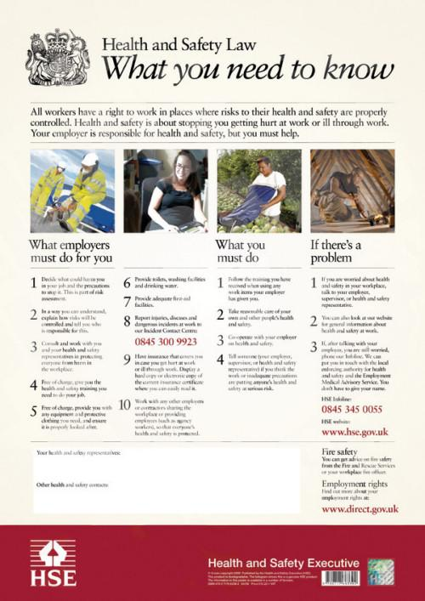
Unit 254
Health and Safety

Slide 2
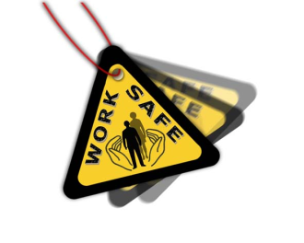
Understanding how a retail business maintains health and safety on its premises
This presentation will cover 5 areas of unit 254
1. Know the main provisions of health and safety legislation in relation to a retail business.
2. Know what actions to take in an emergency
3. Understand the colleagues’ responsibilities in reporting hazards and accidents that typically occur on the premises of a retail business
4. Understand safe handling, storage and disposal
5. Understand safe working practices

Slide 3
Understanding how a retail business maintains health and safety on its premises
Responsibilities
Both colleagues and employers are given responsibilities under legislation that applies to health and safety in the workplace.
Under the Health and Safety at Work Act colleagues must work in a safe and sensible way, use equipment safely, report potential risks and help to identify training needs.
Employers must provide a safe work area, ensure safe systems of work and safe handling, storage and transport of stock, train and supervise colleagues, maintain safe entries and exits, provide adequate temperature, lighting, seating etc. and ensure that visitors are made aware of any hazards.
Further information can be found on the Government Health and Safety website:
Health and Safety Executive

Slide 4
Understanding how a retail business maintains health and safety on its premises
COSHH (Control of Substances Hazardous to Health)
Under the Control of Substances Hazardous to Health regulations (COSHH) employers must assess the risk from hazardous substances, decide how to reduce or prevent those risks, monitor exposure to the risks and ensure colleagues are properly informed, trained and supervised.
Any dangerous substances and items must be stored in a way that minimises the number of people who are exposed to them and the length of time that they are exposed.
Good housekeeping routines will help to reduce health and safety risks.
Making sure that stock is not left in the aisles when replenishing fixtures, not trailing wires across spaces and checking fixtures and fittings for damage such as sharp edges or protruding brackets, will all protect colleagues and the public.
Using equipment and materials according to the instructions given by the manufacturer and your employer will also prevent accidents and emergencies.
Fire exits must also be kept free from obstructions.

Slide 5
Actions in the event of an emergency

Slide 6
Actions in the event of an emergency
Emergencies may occur in a number of different ways.
Every shop will have emergency procedures which it is important that you know.
Remember if you are working in premises other than your normal workplace to find out what the emergency procedures are as soon as possible – it’s too late when the emergency occurs.
Retail premises are occasionally the subject of bomb threats, either from terrorists or criminals looking to exploit the threat.
Procedures for dealing with bomb threats will often include a senior colleague or security making an evaluation of the threat and deciding on the action to be taken.
Where it is decided that a genuine threat exists, the procedure in place for fire evacuation will often be used.

Slide 7
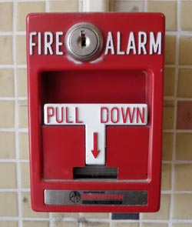
Actions in the event of an emergency
Fire evacuation procedures will cover how to raise the alarm, how to evacuate the building, where the fire exits are, the assembly points, the location of fire extinguishers and when and how to use them.
If you discover a fire, operate the nearest fire alarm.
If you have been trained to do so and the fire is small enough to tackle, use the fire extinguishers on it.
Make sure escape routes are kept clear, someone has called the fire service, customers are directed to the nearest exit and doors and windows are closed.
When the building is empty make sure no one re-enters until the fire service have given permission.
In the event of acute illness or accident, first aiders need to reach the patient as quickly as possible. Call them, don’t try to administer first aid if you are not trained to do so as you could easily cause more harm.
As soon as possible, complete the details of the accident in the accident book, as this will be useful in the event of any dispute over responsibility and also forms a record. This helps to identify recurring accidents so that action can be taken to prevent the risk continuing.
Remember if you have an accident yourself, however trivial it may seem, report it and have it entered in the accident book.

Slide 8
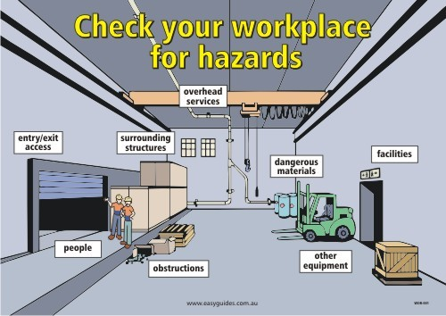
Hazards and risks and Safe Working Practices

Slide 9
Hazards and risks and Safe Working Practices
A hazard is anything that could cause harm.
The risk is the likelihood that the hazard will harm someone and the level of harm involved.
Legislation requires people to be protected from risk as far as is reasonably practicable.
Businesses carry out risk assessments to meet their legal obligations.
The first stage is to look for hazards which might be trailing wires, worn carpets etc., or hazards caused by the work being carried out.
The next stage is to evaluate the risk of harm from the hazards as high, medium or low. High and medium risks will usually require action.
The action stage could involve replacing worn out equipment, changing work practices or changing layouts or lighting.
A record needs to be kept of the risks identified and the action taken to reduce them.
Once a ‘risk assessment’ is carried out safe working practices (SWP) are applied and a supply of relevant equipment such as Personal Protective Equipment (PPE) should be made available.

Slide 10
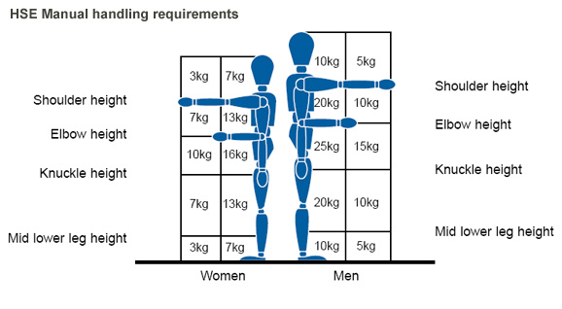
Manual Handling

Slide 11
Manual Handling
A major cause of injuries in the workplace is incorrect handling of stock.
Before lifting or moving any stock you should check that the weight and size will allow you to comfortably handle it.
If in any doubt, ask a colleague to help.
If you decide that you are able to manage it alone, there are techniques that should be followed.
To lift a heavy object, stand with your feet apart, one leg a little ahead of the other, with your back straight and lift smoothly.
If you have to bend, bend your knees, not your back.
Keep the load close to your body with the heaviest side nearest to you.
Avoid twisting your body when turning and place the load carefully to avoid trapping your fingers or feet.

Slide 12
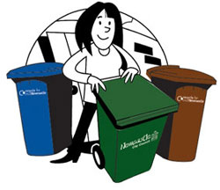
Waste Disposal

Slide 13
Disposal of Waste Rubbish
Waste cardboard, paper, plastic packaging and damaged or out of date stock must be disposed of regularly.
Much of this may be collected for recycling but any hazardous waste such as sharp items, corrosive products or chemicals must be disposed of in line with the COSHH regulations.
Wear protective clothing such as gloves or goggles in order to protect your hands and eyes from any damage.
The following link will tell you more on COSHH:
http://www.hse.gov.uk/coshh/industry.htm
What is RIDDOR, click on the link and find out:
http://www.hse.gov.uk/riddor/reporting-change.htm
Want to know how to carry out a risk assessment:
http://www.hse.gov.uk/simple-health-safety/manage.htm

Slide 14
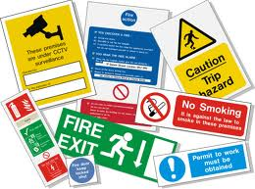
THE END
Thanks and good luck

