Slide 1
Unit 256
Understanding security and loss
prevention in a retail business

Slide 2
Understanding security and loss prevention in a retail business
There are four learning outcomes to this unit:
1. Know the range of security risks faced by a retail business
2. Understand the effect which crime has on a retail business and its colleagues
3. Know what actions can be taken to prevent crime in a retail business
4. Know how security incidents should be dealt with

Slide 3
Security risks
Retail businesses are particularly liable to security risks as they allow members of the public free access to the premises and usually have their stock on open display. This leaves them vulnerable to theft.
Shoplifters will steal anything they can get away with, but particularly high-value, easily portable and easily saleable items.
The 2009 Retail Crime Survey reports that the average value of goods stolen each time by a shoplifter is £45. They also report almost half a million incidents of shoplifting, 22,000 physical attacks on or harassment of colleagues, criminal damage and vandalism incidents at 47% of retail outlets and an increase in burglaries and robberies, each resulting in an average loss of over £2,000.
As the survey indicates that probably more than half of all incidents are not reported, the true figures are a great deal higher.

Slide 4
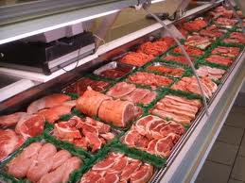
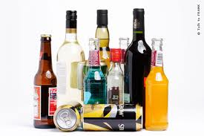
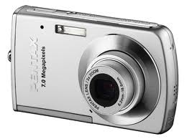
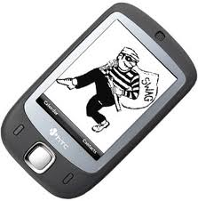
Security risks
As well as this high volume of crime committed by customers, colleague theft costs British retailers nearly £500million a year.
In addition to physically stealing stock, colleagues may collude with others to steal by deliberately e.g. under-ringing goods on the till, ignoring customer theft or signing for goods not delivered.
Other factors to consider: Fraud, Claiming refunds for stolen goods, counterfeit cash or cheques, cloning equipment.
Goods at high risk from theft include; Cigarettes, Tobacco, Alcohol, Electrical (especially small) goods etc. These can easily be re-sold.

Slide 5
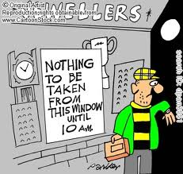
Criminal damage
If theft or burglary is committed when the retail outlet is closed, there will be the added problem of damage to property due to a ‘smash and grab’ type theft.
Often jewellers will suffer this type of crime during opening hours.
Retailers with bank cash machines may also suffer criminal damage when criminals use cars or lorries to crash into premises.

Slide 6
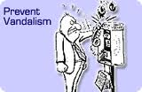
Vandalism and harassment
Unfortunately, vandalism and harassment will occur in most towns and cities.
These things are reduced if retail organisations remain vigilant and maintain premises and the security around them.
The price of vandalism and harassment will have an impact on smaller retailers as it is often unsightly or frightening and will potentially deter customers from shopping.
Broken windows and graffiti are very off-putting and costly to repair.
Colleagues must follow the company’s violence policy at all times to protect themselves from risk.

Slide 7
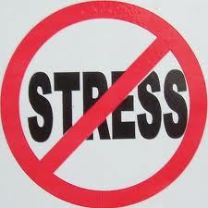
The effects of crime
On average retailers lose between 1% and 2% of sales to crime.
This accounts for a high proportion of their profits.
The total cost of retail crime amounts to £58.14 for every man, woman and child in the UK every year.
As well as the cost to the business, crime affects the colleagues financially; they may have their personal possessions stolen and the loss of profit through crime makes less money available for wages and bonuses.
Colleagues who have been physically attacked or threatened will suffer from physical injury or stress, which may lead to them having to take time off or even leave their jobs.
Psychological effects of working in an atmosphere of intimidation or harassment may lead to them taking additional time off, which itself puts extra pressure on remaining colleagues.

Slide 8
Crime prevention
Retailers will take various actions and precautions to secure stock, premises, cash, people and information from criminal activity.
These will include the use of uniformed security colleagues, who deter crime and plain-clothed colleagues who monitor suspicious behaviour.
Security devices such as electronic tags, CCTV and alarms are used to reduce shoplifting.
Computers holding information on stock and customers will be protected by passwords and the use of authorisation levels which limit the ability of colleagues to access particular functions such as voiding transactions or actioning refunds.

Slide 9
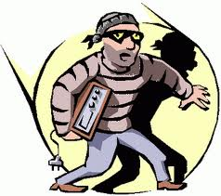
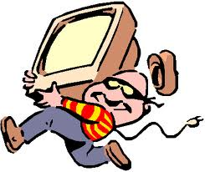
Crime prevention
To reduce the level of colleague theft, retailers will put procedures in place to search the bags and lockers of colleagues either randomly or all colleague bags on leaving the building.
Colleague activity may be monitored by the use of CCTV, security colleagues or management observing the colleagues as they go about their tasks.
Colleague uniforms and name badges will identify colleagues in restricted areas, doors may have electronic entry devices, colleague purchases may be strictly controlled and refuse bags may be transparent to prevent stock being removed from the premises in them for retrieval later.

Slide 10
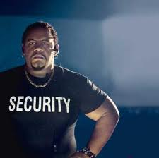
Dealing with incidents
If you are faced with a security incident, you must ensure that you comply with legislation and company guidelines.
Under the Police and Criminal Evidence Act (PACE) only the police have the authority to search people, cars or premises. Many retailers will have a company policy of not confronting criminals where this might put the colleagues at risk.
If you see criminal activity you must keep the suspicious character in view and maintain vigilance so that they cannot dump stolen items or pass them on to someone else.
When you are sure a theft has taken place, make a mental note of the description of the suspect and report the incident as promptly and accurately as you can to a nominated or authorised person.

Slide 11
Dealing with incidents
You have the authority to arrest a suspect and to ask them to empty their pockets or bags, but you do not have the authority to insist.
Searching someone without permission risks an assault charge so make sure there is a third person present, especially if the suspect is of the opposite sex.
Be careful not to disclose your personal details or those of anyone else to anyone other than the police as this may cause problems in the future.

Slide 12
THE END
Thanks and good luck

