Slide 1
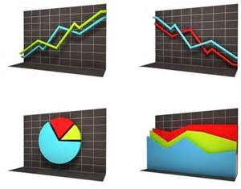
Graphs and Charts
Presented by Bill Haining
Notes:
April 2012. Kindly contributed to www.skillsworkshop.org by Chris Farrell, Bolton College.

Slide 2
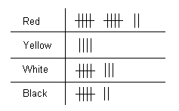
Tally Charts
A tally chart provides a quick method of recording data as events happen.
Tally marks are drawn as vertical strokes – I - until there are four. Then
the fifth stroke is drawn across the previous four IIII. This is continued until
all the data is collected. The advantage of this method of tallying is that
objects can be counted quickly and easily at the end.
Notes:
April 2012. Kindly contributed to www.skillsworkshop.org by Chris Farrell, Bolton College.

Slide 3
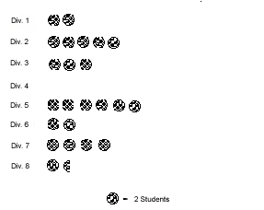
Pictograms (or pictographs) show the data as pictures. The pictures
represent a number of items.
The Pictogram it must also have a Key, for it to make sense.
Number of students who like chocolate chip cookies best
Pictograms
The key tells us ‘how many’ each
picture represents.
Key
Pictograms are not usually the best graph to use, because data can be
more easily represented in bar graphs.
Notes:
April 2012. Kindly contributed to www.skillsworkshop.org by Chris Farrell, Bolton College.

Slide 4
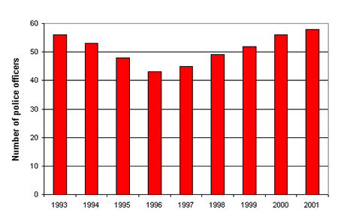
Bar Charts
Bar charts are used to compare data.
The bars are usually vertical
title
Number of police officers in Crimesville, 1993 to 2001
y
vertical axis
(or, y axis)
scale
(must show
correct units
cm. ◦c, £ etc))
horizontal axis
labels
(or, x axis)
x
Years
The height of the bars tells us ‘How Many?’ ‘How much?’ ‘How often?’ or ‘How high, or low?’
Notes:
April 2012. Kindly contributed to www.skillsworkshop.org by Chris Farrell, Bolton College.

Slide 5
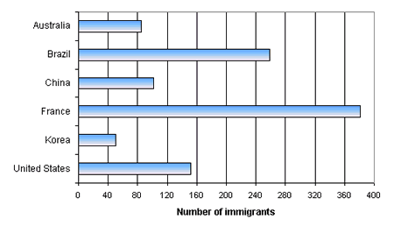
The bars can be
horizontal.
Number of students at Diversity college who are immigrants, by last country of permanent residence
Last Country
of residence
Notes:
April 2012. Kindly contributed to www.skillsworkshop.org by Chris Farrell, Bolton College.

Slide 6
Number of police officers in Crimeville, 1993 to 2001
‘Single bar’ charts compare data in one set, to look for patterns.

Slide 7
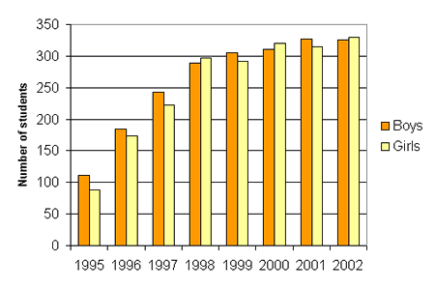
Dual bar charts
Some bar charts compare two, or three sets of data.
Internet use at Redwood Secondary School, by gender, 1995 to 2002
Key
Year
This is a dual bar chart. It compares 2 sets of data. This chart must have a
Key.
The key identifies the bars.
Notes:
April 2012. Kindly contributed to www.skillsworkshop.org by Chris Farrell, Bolton College.

Slide 8
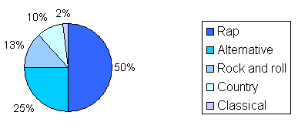
Pie Charts
Music preferences in young adults 14 to 19
A pie chart must
also have a key.
This identifies the
sectors
Sectors
Pie Charts are used to show proportions, fractions and
percentages in sets of data.
The sectors describe the different parts of the data.

Slide 9
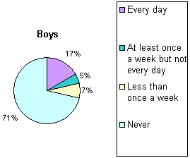
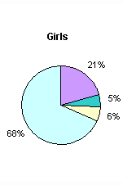
Dual Pie Charts
It is possible to use dual pie charts to compare data, but they are not
as clear as dual bar charts. It can be difficult to see the difference between a sector
in one chart and its corresponding sector in the other chart.
Smoking frequency of 15-year-olds on the
Parkview Secondary School track and field team
Notes:
April 2012. Kindly contributed to www.skillsworkshop.org by Chris Farrell, Bolton College.

Slide 10
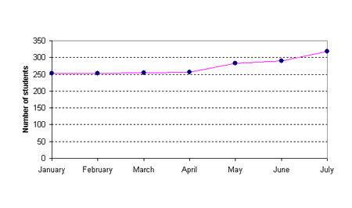
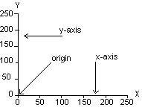
Line graphs are used to show direction,
or change in direction. They tell us what
happens over a period of time.
This is called
Line graphs
trend.
Title
School students in the workforce.
To start a line graph
Scale
Plotted line
Scale
Labels
When drawing a graph, it is important that you use the correct scale.
You mark (plot) the data on the graph with points or crosses
Notes:
April 2012. Kindly contributed to www.skillsworkshop.org by Chris Farrell, Bolton College.

Slide 11
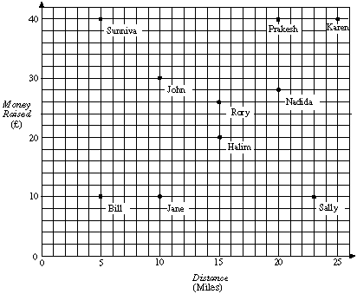
Scatter graphs
Money raised in a sponsored walk
Scatter graphs are used
to se if there is a
connection ( relationship)
between 2 sets
of data.
Like the line graph the axes must
be evenly spaced, but the scales
don’t have to be the same on
each axis.
Like the line graph, you plot points on the grid, but you do not join the points.

Slide 12
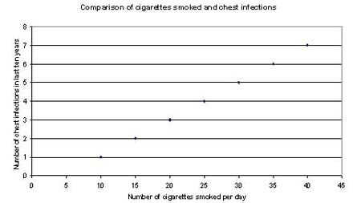
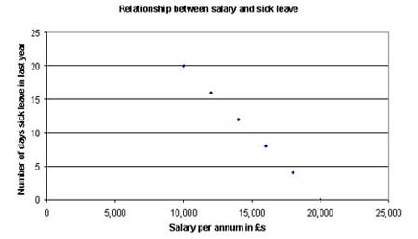
Scatter graphs
Correlation
positive
negative
Scatter graphs show a positive or negative correlation (relationship)
between 2 sets of data.
Notes:
April 2012. Kindly contributed to www.skillsworkshop.org by Chris Farrell, Bolton College.

Slide 13
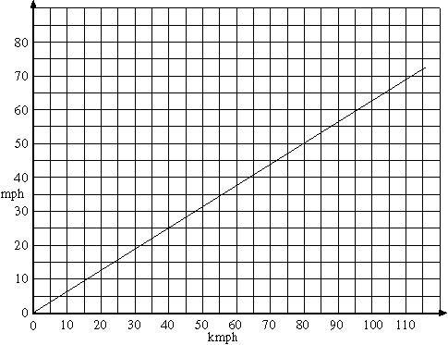
Conversion graphs
Conversion graphs make changing from one unit of measure to another easy.
In this graph you can convert
Kilometres to miles or vice versa.

Slide 14
Graphs and charts.
Summary
When you collect information in a survey, you record the data
in a tally chart or frequency table
Bar charts are used to compare data.
Dual bar charts compare two sets of data.
Pictograms (or pictographs) show data as pictures.
These charts show discrete data.
Discrete data has exact values e.g. shoe sizes 3,3½,4,4½ etc.
******************
Line graphs are used to show trends or changes. i.e. Is something increasing,
decreasing or static ( level, not going up or down) ?
They are used for continuous data.
Continuous data does not have exact values e.g. lengths -3.48 cm,
weights -67.39kg or temperature.
******************
Pie Charts are used to show proportions, fractions and
percentages in sets of data.
Scatter graphs are used to see if there is a connection ( relationship)
between 2 sets of data.
Conversion graphs changing units of measure from one system to another
e.g. £(pounds) to €(euros).
Notes:
April 2012. Kindly contributed to www.skillsworkshop.org by Chris Farrell, Bolton College.

Slide 15
Good Luck
THE END

