Slide 1
Selling a Product or Service
Unit 252: Understanding
the Retail Selling Process
Presented by Bill Haining

Slide 2
Introduction In this unit we will cover the following topics:
The 5 steps to selling model
Questioning techniques
Objections
Closing the sale
The importance of product knowledge
Recognising buying signals

Slide 3
The 5 steps to selling model
In a retail context there are 2 types of selling:
Accepting payment from a customer who has already decided exactly what they want buy.
Persuading a customer to buy something that they haven't already made their mind up to buy.
It is in this 2nd situation that the 5 steps to selling model is used

Slide 4
5 steps to selling model
1-2
Acknowledge and approach
Identify customer needs (Qs)
2-3
Present solutions that satisfy features and benefits
Overcome objections and check commitment to buy. (Use open and closed Qs, offer solutions)
5
Close the sale

Slide 5
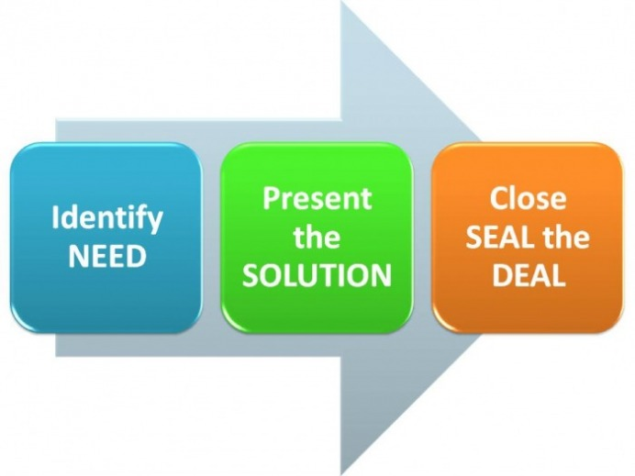
5 steps to selling model
To identify customers needs, it is important to create an effective rapport with the customer.
Customers will be more likely to buy from someone they like or identify with.
Dictionary Definition:-
rapport
-noun relation; connection, especially harmonious or sympathetic relation.

Slide 6
Questioning Techniques
There are 2 types of questions you can use when establishing your customers needs:
Open, these invite the customer to give a full response, e.g.
2. Closed, these type of questions will mainly only
require a yes/no answer

Slide 7
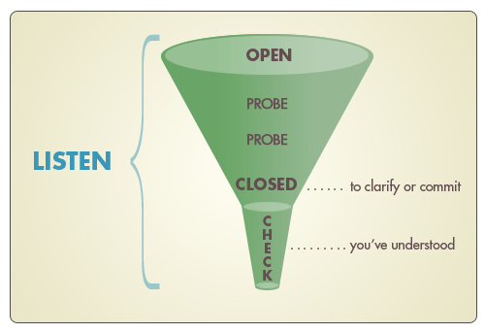
Questioning Techniques
When establishing customer needs you may have to use probing questions to offer solutions or alternatives.
(Probing: To search into or examine thoroughly; question closely.)
Having obtained as much information as possible about your customers needs, you will be able to offer possible solutions. If a customer indicates a clear choice, check that they are ready to make a purchase by re-stating their selection and asking them if they want to go ahead

Slide 8
Objections
If the customer is unable to indicate a clear choice, they may have objections to all the options.
The service they would really like may be too expensive while the service they can afford may not fully meet their requirements. To deal with objections, listen to gain information so you can offer solutions and alternatives

Slide 9
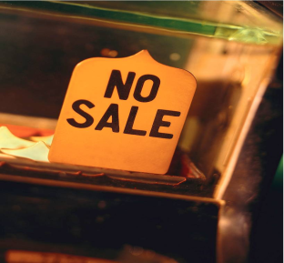
Closing the sale
Closing the sale means agreeing with the customer that you both understand what the customer needs, how much they are paying for it, how they are paying for it and when they are receiving it.
The 3 most common “Closing the sale” techniques are:
Assumptive
Decision
Straightforward

Slide 10
Closing the sale
The Assumptive close, where you say “I'll ring this up for you” and the customer has to stop you if their not buying.
The Decision close, where you ask “Would you like that in blue or black”.
The Straightforward close, where you ask the customer if the product is what they are looking for. If the answer is yes, you have made the sale, if no, go back and overcome the objections.

Slide 11
The Importance of Product Knowledge
You will not be able to sell products or services unless you have an in-depth knowledge of them so you can answer any queries the customer may have.
The most important information relates to the features and benefits.
Features: Describe what the product or service is.
Benefits: These describe how the features meet the customers needs.

Slide 12
The Importance of Product Knowledge
Making the right sale for the customer is very important. (Meet the customers needs)
The satisfied customer will return a number of times. (This will result in a higher level of sales)
Demonstrating goods such as cooking utensils and materials can be very effective in making a sale.
The information needed in order to improve and maintain your product knowledge can be found on POS material, instruction manuals, packaging as well as the experience of your colleagues and training session.

Slide 13
Recognising the BUYING signals
When a customer is ready to make a purchase, they will display buying signals.
-They may be looking at 1 type of product for a time, looking around for help, asking questions, asking about price, discussion or asking another's opinion or getting out their cash.
-When a person is ready to but then you should also be ready to pick them up and move them towards the final close, At this point you can ask questions which will identify whether addition sales can be made.

Slide 14
Recognising the BUYING signals
Traditionally customers have mistrusted sales people as they have suspected them of using “Hard Sell” to persuade them to but something they didn't really want
This can be overcome by listening to the customer to find out what it is that will best meet their needs and supplying it to them at the best possible price

Slide 15
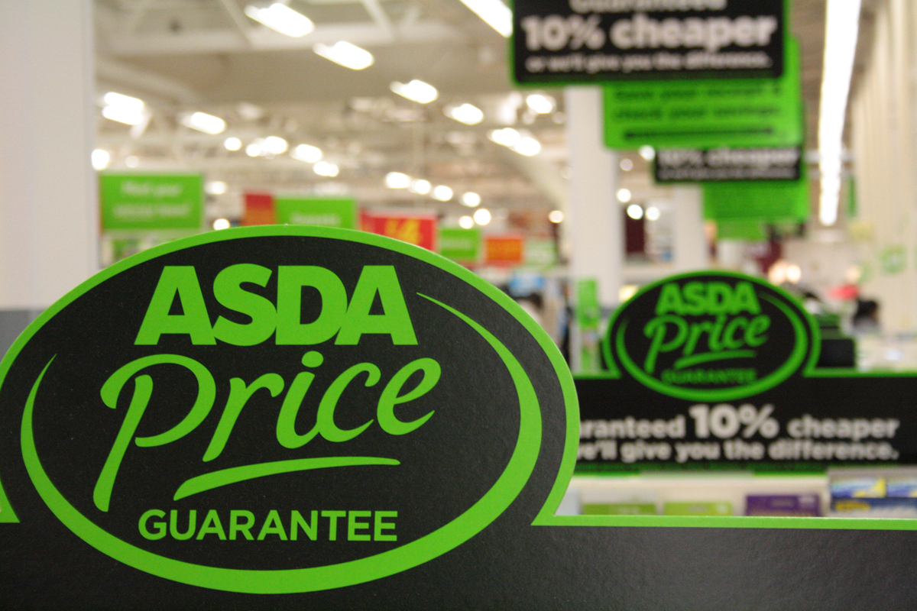
THE END
Thank you and good luck

